Slide 1
Notes:
Good morning
Today we have a knowledge sharing session for u in place with handson exercises so that at the end of the next couple of hours, you would have a bootstrap guide for urself in place for all ur future references. Hence we urge u to participate actively and make this a two way communication. Lets learn togather.
We have organized this session in modules and we have a working session at the end of each of these sessions to implement stuff that we would be covereing during the presentation
So before we go any further, we are passing around pendrives with a folder named, bits_ -----please copy it to ur system…and sit back..dont get too curious yet!! We will speak about it more a lil later. Copy and pass it on.

Slide 2

BootSTRAP
Responsive UI
Mobile first approach applications
Notes:
this session is on bootstrap the framework that is built around making responsive ui’s and mobile first approach convininet.
We have organized this session in modules and we have a working session at the end of each of these sessions to implement stuff that we would be covereing during the presentation
So before we go any further, we are passing around pendrives with a folder named, bits_ -----please copy it to ur system…and sit back..dont get too curious yet!! We will speak about it more a lil later. Copy and pass it on.

Slide 3


Presenters
Rahul Dcosta
Miracle DSouza
Software Developer
Travel Network
Software Developer
Travel Network
Notes:
So let me begin by introducing my self to you – I am miracle Dsouza , software developer at sabre – under the travel netwok BU and I will be your presenter for the day along with my collegue here – would u like to introduce your self ?

Slide 4

ITPL,Bangalore
11 years Sabre and counting …..
Notes:
2016 Great place to work
3rd largest Development center

Slide 5

Agenda
1
Module 1: Introduction - Miracle
2
Module 2: Web app basics - Miracle
3
Module 3: Getting started - Rahul
4
Module 4: Navigation - Rahul
5
Module 5: Layout - Miracle
Notes:
Why Mobile first and responsive UI’s?
What is bootstrap?
What i snew in bootstrap 4 – flexbox, cards
Why bootstrap over other frameworks?
How to debug different viewports at the browser
Viewports
Media queries for mobile first approach
Bootstrap icons
Navigation
Grids
Forms
Bootstrap 4 Jumbotron
Bootstrap 4 Badges
breadcrumbs
Pagination
flexbox
Learning cards in Bootstrap 4
Bootstrap and customized alerts
Css key frames
Progress bars
Scrollspy
Bootstrap 4 Carousel
Bootstrap 4 Tooltip
Overview Bootstrap 4 Utilities
Hands on Experience with Bootstrap
A basic webpage skeleton will be provided
We will implement the concepts mentioned above as we introduce them to you.
At the end you will have a mobile first cum responsive webpage built.

Slide 6
Agenda
6
Module 6: Content - Miracle
7
Module 7: Component , Set 1 - Rahul
8
Module 8: Component , Set 2 - Rahul
9
Module 9: Utilities - Miracle
10
Module 10: Animations & Icons - Miracle
11
Module 11: - Final Challenge - Rahul
Notes:
Now the working sessions I mentioned a while back-----------they will cover the concept covered in that module- we will set u a goal that you need to accomplish by implementing just what we will be speaking during that module. Fair enough???
To get u rolling we have provided you with the skeleton file in the input folder of the respective module and you build over that. Hence we are doing away from u starting from scatch , which in turn will help us better concerntrate on what is important.
Yeah!! Lets begin

Slide 7

Module 1: Introduction
Know Responsive UI
Know Mobile first approach
Know Bootstrap
Comparison with other versions and libraries
Browser support
Debugging guides

Slide 8
Responsive UI & Mobile first approach
Responsive - Flexible layouts, flexible images and cascading style sheet media queries.
Mobile first approach - Design for smaller screens first – progressive enhancement.
Is there a difference between the two?
mobile-first is actually a design strategy responsiveness is the result of a technical approach
Notes:
The goal of responsive design is to build web pages that detect the visitor's screen size and orientation and change/adapt/adjust the layout accordingly to look presentable/look good.
1 application- viewed on different devices- single codebasae-----------look is the same
No separate designs &&&&& adapts on the fly/automatically – that makes it a technical approach – the automation or automatic chnge is technicality
Mobile first – is a design approach because its about giving in lot of thots on how u want to see the application on different devices---------------look can vary
Eg: advertisement covering fone screen or menu bar going to two lines or expandable menu(what wud u prefer??????????????)
It’s about starting small n build up for bigger screens – no overhead – no discarding – no wastage –hoaders pain
Incremental- progressive –additive building – scale upwards
Unlike graceful degradation- desktop first –optimal for big screens – lose market on fones – adapt poorly to mobile even if responsive as told in eg
Rui or mfa??????????????????????????????????????????client based

Slide 9
Why Mobile first and responsive UI’s?
Did you know ??
68 million Google searches are carried out on mobile devices every hour around the globe?
What’s more: 69% of travelers start their online searches on a mobile device!
In fact, mobile bookings in the travel industry grew by 1700% between 2011 and 2015, moving from 1% to 18% of online revenues.
Notes:
Shopping trend changed – buying on fones over laptops
Rui: one code base – simple to maintain, save expenditure,easier to handle or improve, no scrolls
MFA: convenient to mobile users, on the fly, better user experience
In gen: ui is face the world sees- backend can be impressive bt the ui has to be attractive and sticky for customers – it has to b pleasing to the eye – the positive vibe plays a big role in shaping a product market.
Shabby – unapproachable will push cust away.
Would u prefer scrolls n header covering ur frst screen or a image which is 2 screens big? If we wudnt – custmorers are finally people like us --- y wud they want something like that?

Slide 10
What is bootstrap?
It is a library for responsive, mobile-first projects with the world's most popular front-end component library.
It is an open source toolkit for developing with HTML, CSS, and JS.
Notes:
Lib – ready to use stuff in the form of class
Most popular
Provides html ,css,js templates for typography,forms,buttons,navs and everythn under the sun literally
Easy to use and learn and
easy n quick dev
In place of endless adjustments with margin n padding/display n visibility n spans n div creation-----------simply use classes- ready made--------why wud u cook biryani whenu can make maggi???????

Slide 11
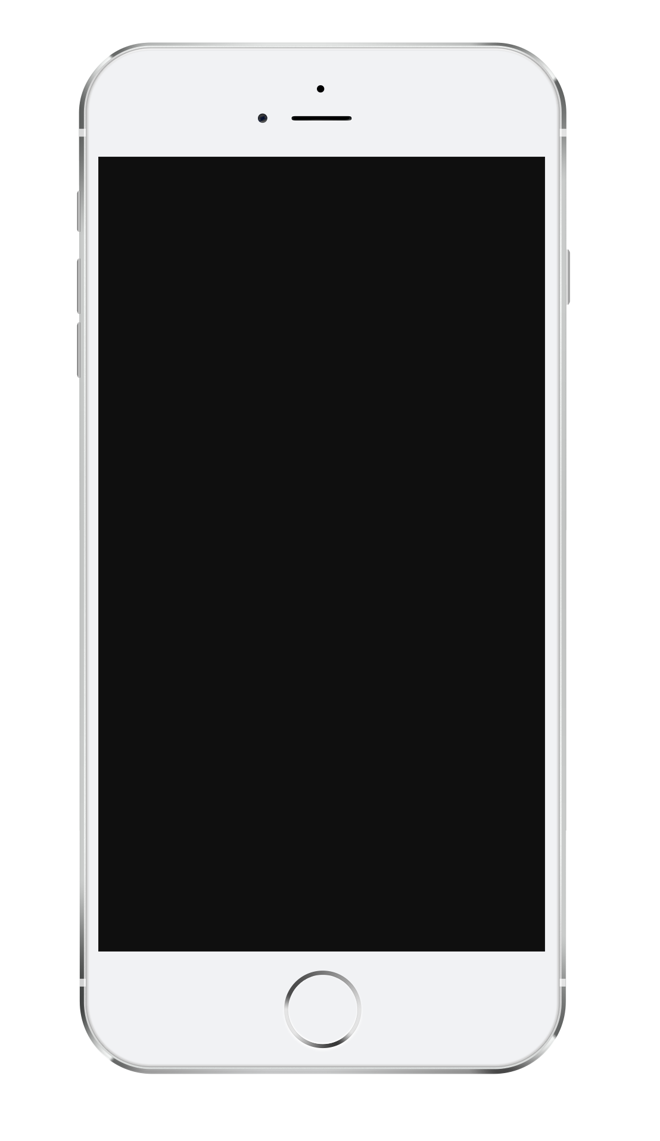
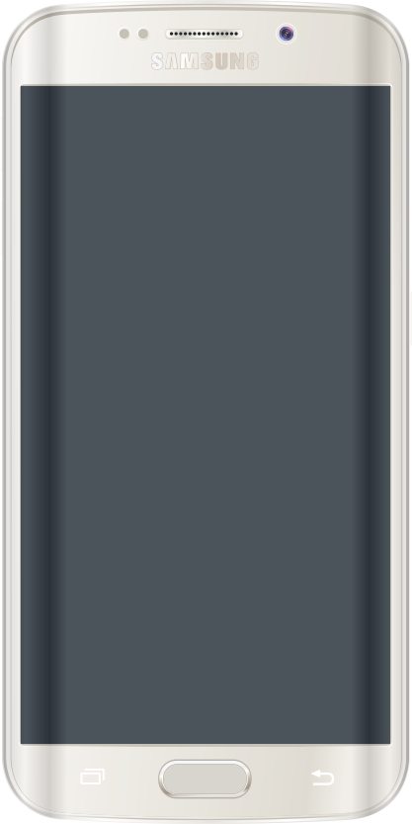
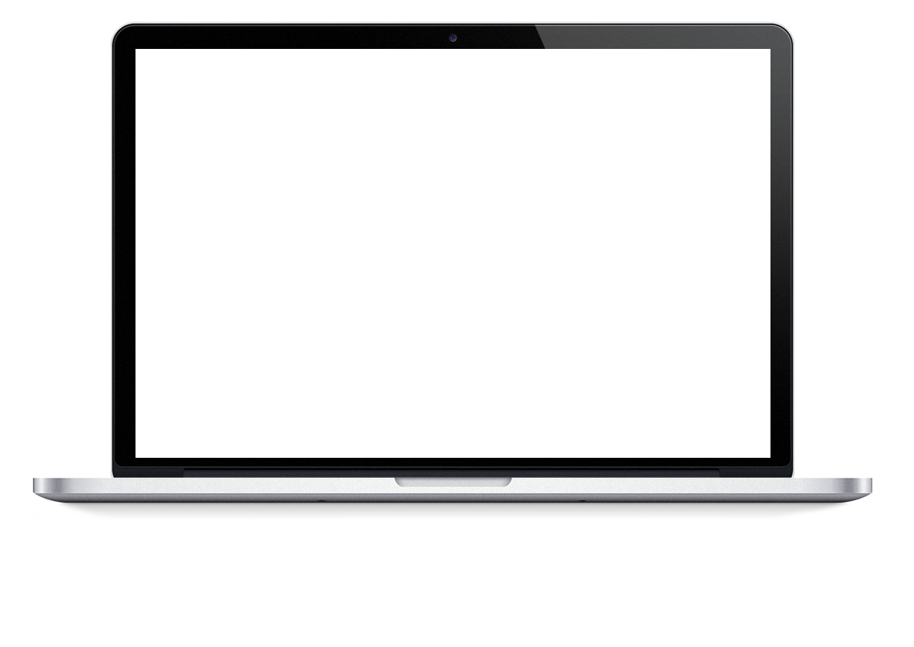
Other device options to use
iPhone 6
Samsung Galaxy S6
Desktop

Slide 12
What is new in bootstrap 4
new components, faster style sheet and more responsiveness.
Major rewrite of the entire project with below differences
New | Dropped
Flexbox by Default | Glyphicons
LESS to Sass | Grunt
REM | panels
Additional Breakpoint Tier
Reboot
Focused Browser Support
Cards
Notes:
In order to support responsiveness n mobile first the bootstrap prj has undergone major rewrite
Specially of thing that kept it back from being full fledged in these areas – ie8 stopped /////ie9 just enuf support
Glypycons stopped coz users used others plus if error – creators to be contacted
Grids –same just spacing changed ----units in rem
Rem – dynamic & relative untis to root html tag
If html tag changed – everything chnges relatively hence saves u trbl of coding
16px=1rem
Supports pt px em bt b4 supports rem for typography
Media queries have better brakepoints to identify devices more clearly – can be defined in sass variables
Cards replace wells , panel(tab) – flexible n extensible
Content containers ----header/footer/bg/display n everything
Utility classes

Slide 13
Advantages of Bootstrap:
Easy to use
Responsive features
Mobile-first approach
free set of tools /common interface components.
Very less coding
Consistent design
Open source
Compatibility with browsers
Notes:
Easy to use: Anybody with just basic knowledge of HTML and CSS can start using Bootstrap – base to learn other frameworks
Responsive features: Bootstrap's responsive CSS adjusts to phones, tablets, and desktops
The biggest advantage of using Bootstrap is that it comes with free set of tools for creating flexible and responsive web layouts as well as common interface components.
Mobile-first approach: In Bootstrap 3, mobile-first styles are part of the core framework
Additionally, using the Bootstrap data APIs you can create advanced interface components like Scrollspy and Typeaheads without writing a single line of JavaScript.
Save lots of time — You can save lots of time and efforts using the Bootstrap predefined design templates and classes and concentrate on other development work.
Consistent design — All Bootstrap components share the same design templates and styles through a central library, so that the designs and layouts of your web pages are consistent throughout your development.
Open Source — And the best part is, it is completely free to download and use.

Slide 14
Browser support
Bootstrap is compatible with all modern browsers
Chrome,
Firefox,
Internet Explorer,
Safari,
Opera
Bootstrap 4 supports the latest, stable releases of all major browsers and platforms. However, Internet Explorer 9 and down is not supported.

Slide 15
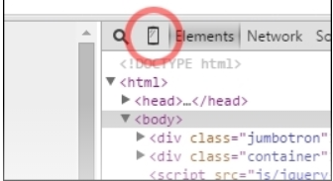
How to debug different viewports at the browser
Right-click on the page and click on Element inspector
Go to the setting, click on More tools, and select Developer tools
The shortcut to open it is Ctrl + Shift + I (cmd for OS X users)
F12 in Windows also works (this is an Internet Explorer legacy)
In the Developer tools, click in the mobile phone on the left of a magnifier

Slide 16

Quiz
Notes:
Which browser support is stopped in b4
What units are given more importance? Rem pt px em
Why rem as the primary units?
Glyficons stopped support, why?
RUI is technical or design approach? n what abt mobile first
What is the approach consired t b opposite of mobile first – graceful dedrag
When to use rui n when mobile first?

Slide 17
MODULE 2: WEB APP BASICS
Brief introduction to HTML
Brief introduction to CSS
Bootstrap setup

Slide 18
HTML BASICS
HTML tags are not case sensitive
Tags encapsulate a trail of attributes or content which inturn can be tags
Attributes usually come in name/value pairs like: name="value“
Double quotes around attribute values, but single quotes can also be used too.
<h1> <p> <a> <img> <span> <div>
<b> <strong <i> <em> <mark> <small>
<del> <ins> <sub> <sup> <q> <blockquote>
<table> <abbr> <cite> <ul> <li> <ol>
Notes:
Not strict
Tags= other tags n attrs
Attr : key val pairs
Predefined xmls type tags
Render content n not display tags
Defines struct of appliucation
H1-h6
<b> - Bold text
<strong> - Important text
<i> - Italic text
<em> - Emphasized text
<mark> - Marked text
<small> - Small text
<del> - Deleted text
<ins> - Inserted text
<sub> - Subscript text
<sup> - Superscript text
Q
Cite
blockquote

Slide 19
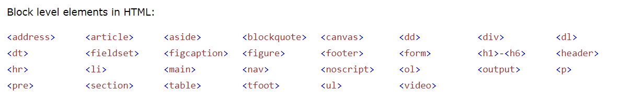
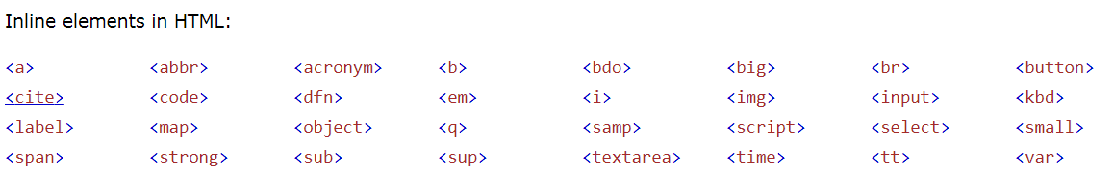
HTML: BLOCK V/S INLINE ELEMENTS
Notes:
Block level – new line –full width
Inline – continued on dsame line – just enuf width
Both define section in doc
Block can hav other tags
Inline hav content

Slide 20
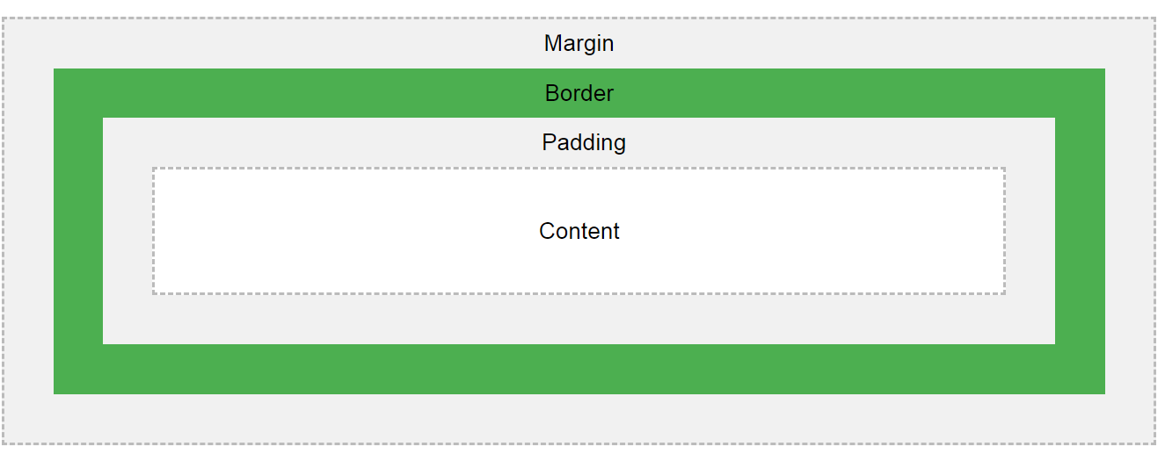
CSS BASICS
CSS defines the look of an HTML document.
CSS tells how HTML should be displayed.
Inline css vs external css
CSS Box model
Fonts color
Display visibility
Float overflow
Align position
Notes:
Padding inside
Margin outside
B0rder marks boundary of ele or container
Beautification of content - looks

Slide 21
CSS BASICS: CSS Selectors
The element The ID
p { #para1 { text-align: center; text-align: center; color: red; color: red; } }
The class The groups
p.center { h1, h2, p { text-align: center; text-align: center; color: red; color: red; } }
Notes:
An id name cannot start with a number!
Based on tag, class id grps
Custom css

Slide 22
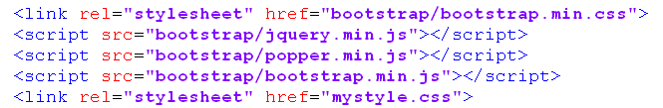
BOOTSTRAP SETUP
Download from getbootstrap.com
unzip the compressed folder to project folder
Include bootstrap css and js in html file as
<head>
</head>

Slide 23
Challenge 1
Notes:
Background image full
Text white
Import Bootstrap through links
font

Slide 24
MODULE 3: Getting started
Viewport
Media queries for mobile first approach
Container

Slide 25
Viewport
Meta tags are snippets of text that describe a page's content.
Not Visible on UI.
Notes:
Always include the viewport <meta> tag inside the <head> section of your document to enable touch zooming and ensure proper rendering on mobile devices
Also include the X-UA-Compatible meta tag with edge mode, which tells the Internet Explorer to display the webpage in the highest mode available.
A <meta> viewport element gives the browser instructions on how to control the page's dimensions and scaling.
The width=device-width part sets the width of the page to follow the screen-width of the device (which will vary depending on the device).
The initial-scale=1.0 part sets the initial zoom level when the page is first loaded by the browser.

Slide 26
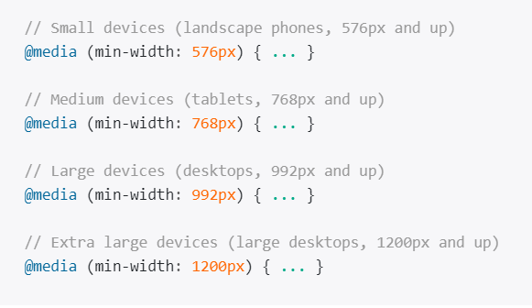
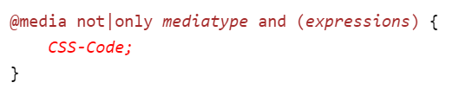
Media queries for mobile first approach
It made possible to define different style rules for different media types eg. phones, tablets, laptops etc.
Notes:
Media queries can be used to check many things, such as:
width and height of the viewport
width and height of the device
orientation (landscape or portrait mode)
resolution

Slide 27
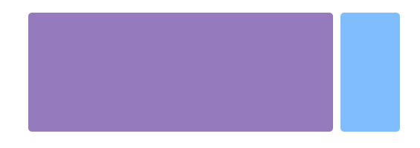
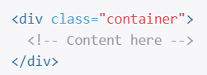
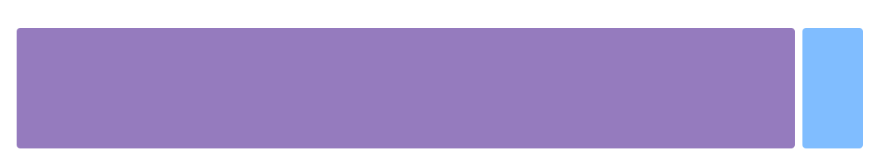
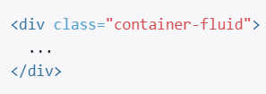
Container
Containers are the most basic layout element in Bootstrap and are required when using our default grid system
They can be nested
Notes:
Choose from a responsive, fixed-width container (meaning its max-width changes at each breakpoint) or fluid-width (meaning it’s 100% wide all the time).
Use .container-fluid for a full width container, spanning the entire width of the viewport.

Slide 28
Challenge 2
Notes:
Add view port so site becomes mobile first
Add media queries to change text color based on max-width
Make div as fluid container

Slide 29
MODULE 4: Navigation
Nav Bar
Bread Crumbs
Scroll Spy
Pagination
Search Bar

Slide 30
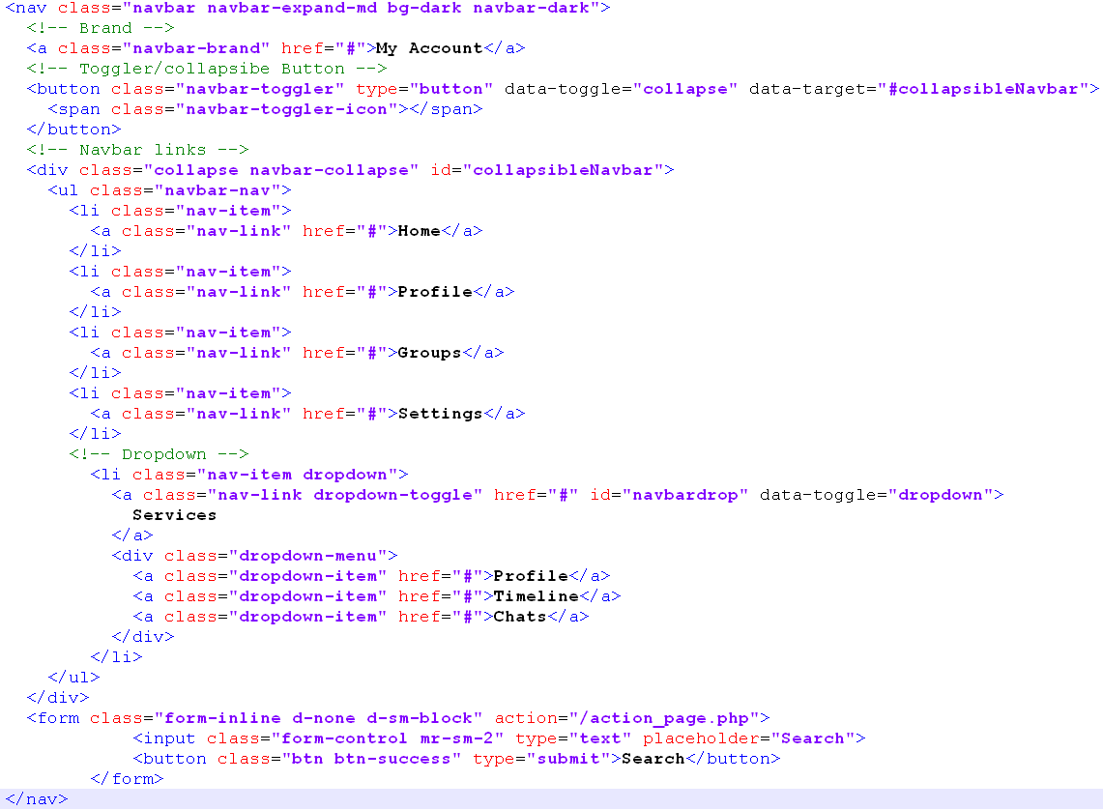
Nav Bar
A navigation bar is a navigation header that is placed at the top of the page.
With Bootstrap, a navigation bar can extend or collapse, depending on the screen size.

Slide 31
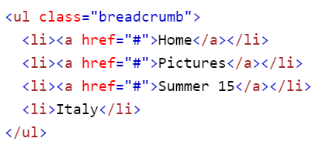
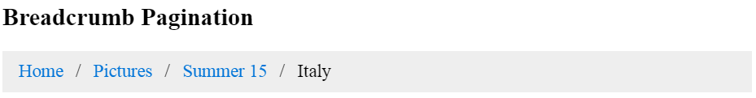
Bread Crumbs
A breadcrumb navigation provide links back to each previous page the user navigated through, and shows the user's current location in a website.
It’s a alternate form of pagination.

Slide 32
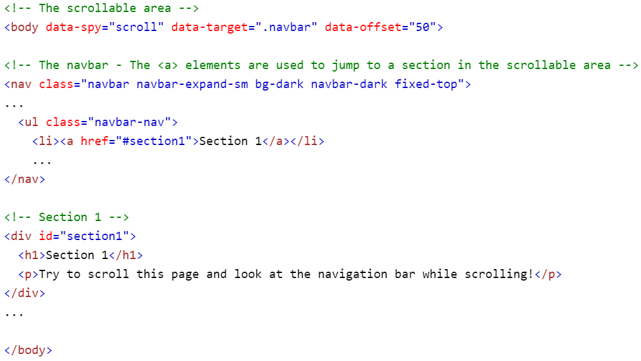
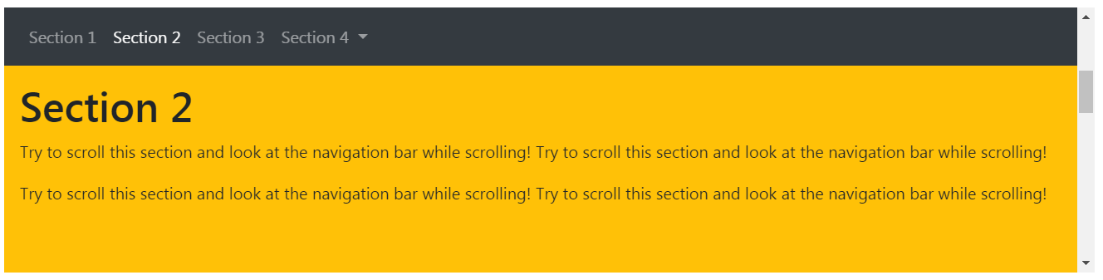
Scroll Spy
Scrollspy is used to automatically update links in a navigation list based on scroll position.
Notes:
Often used on scrollable area like body

Slide 33
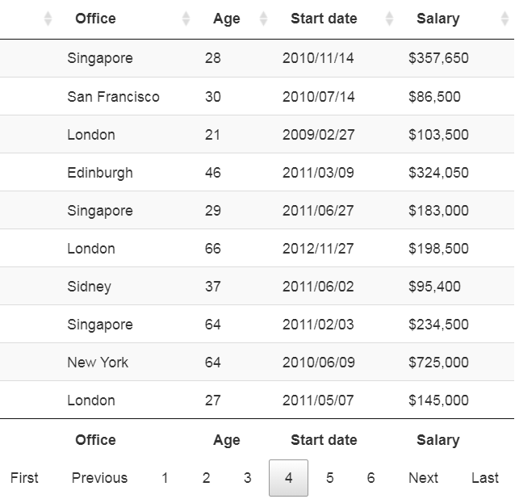
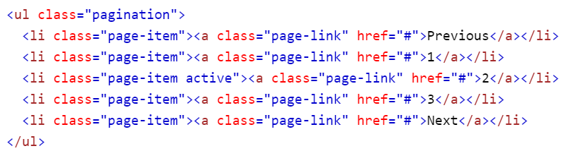
Pagination
If you have a web site with lots of pages, you may wish to add some sort of pagination to each page.

Slide 34
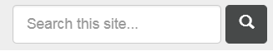
Search Bar
Allows users to quickly find content on website quickly.

Slide 35
Challenge 3
Notes:
Add nav bar with links
Add search button
Add breadcrumbs
Add pagination after p tag

Slide 36
MODULE 5: Layout
Grid System
Media Object
Flex Box
HTML5 Semantic Elements

Slide 37
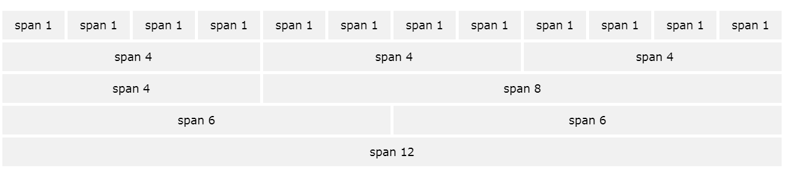
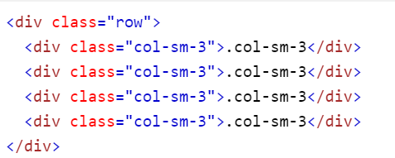
Grid System
Bootstrap’s grid system uses a series of containers, rows, and columns to layout and align content. It’s built with flexbox and is fully responsive.
Notes:
Grid system
5 classes : col-,sm,md,lg,xl – combine them to form dynamic n flexible layouts
12 cols,Can grp them
Grid is responsive
Rows, cols – rearranges based on screen size
The Bootstrap 4 grid system has five classes:
.col- (extra small devices - screen width less than 576px)
.col-sm- (small devices - screen width equal to or greater than 576px)
.col-md- (medium devices - screen width equal to or greater than 768px)
.col-lg- (large devices - screen width equal to or greater than 992px)
.col-xl- (xlarge devices - screen width equal to or greater than 1200px)

Slide 38
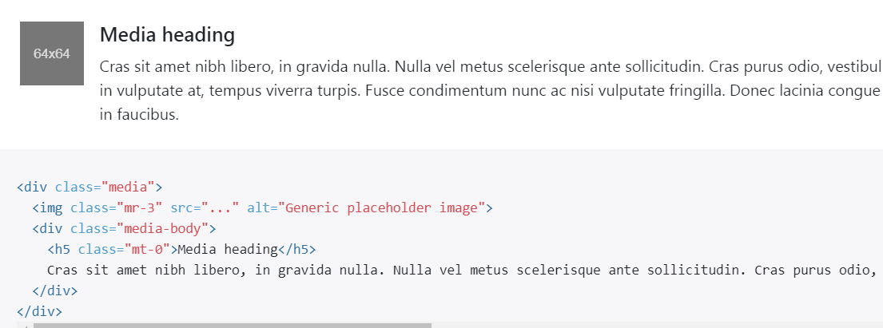
Media Object
The media object helps build complex and repetitive components where some media is positioned alongside content that doesn’t wrap around said media
Notes:
Media obj – compelx n repititve components where some media is positioned alongside – no content wrpping – minimal claases reqd

Slide 39
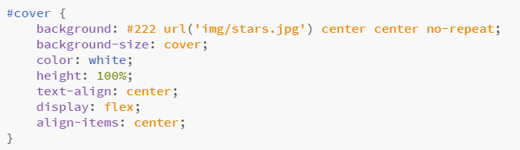
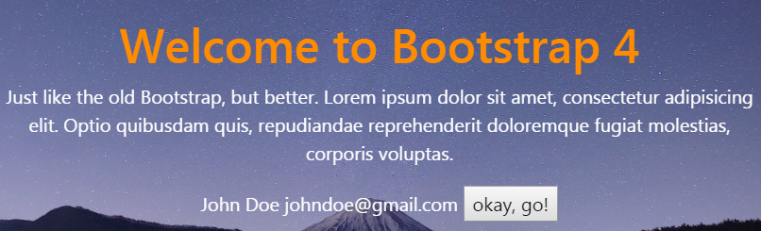
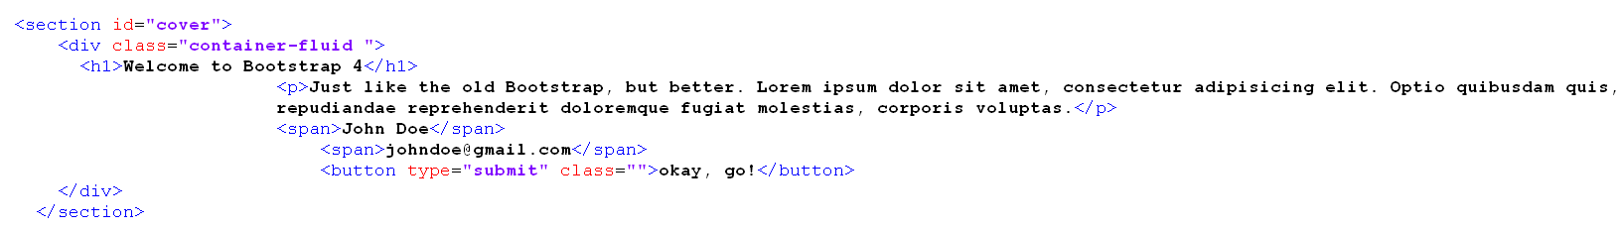
Flex Box
Quickly manage the layout, alignment, and sizing of grid columns, navigation, components, and more with a full suite of responsive flexbox
Notes:
Flexbox – earlier it was about using floats
now recommendation is design websites using flexbox coz it gives u more control ,flexibility n ease to create complex sites
and use floats to move content around for magazine style. Float control was limited had to use other atrrs for placing(margin/padding)
Can define alignment, direction, order, size without use of other attrs

Slide 40
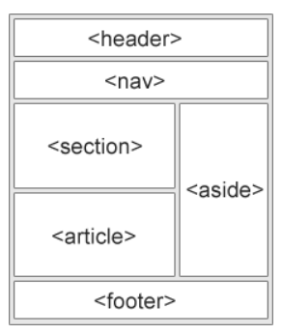
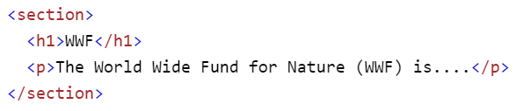
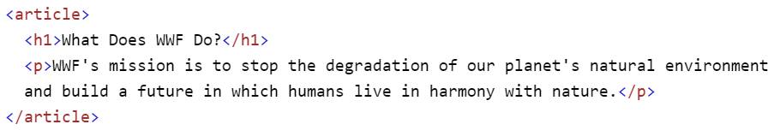
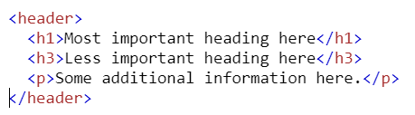
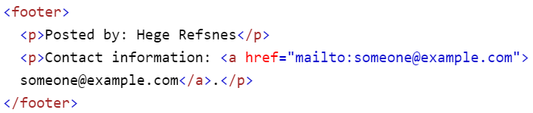
HTML5 Semantic Elements
Websites often display content in multiple columns(like a magazine or newspaper).
HTML5 offers new semantic elements that define the different parts of a web page.
Notes:
<header> - Defines a header for a document or a section
<nav> - Defines a container for navigation links
<section> - Defines a section in a document
<article> - Defines an independent self-contained article
<aside> - Defines content aside from the content (like a sidebar)
<footer> - Defines a footer for a document or a section
<details> - Defines additional details
<summary> - Defines a heading for the <details> element

Slide 41
Challenge 4
Notes:
Make use of grid system
Use flex box for 1st section
Place 3 different media objects in grids
Add a footer at bottom and bring text to center

Slide 42
MODULE 6: Content
Tables
Lists
Forms
Image Thumbnails
Card

Slide 43
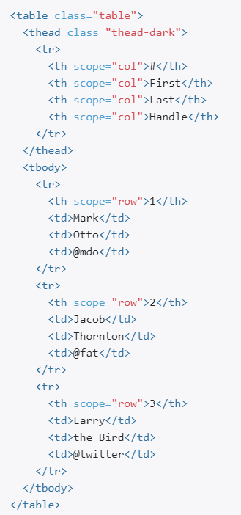
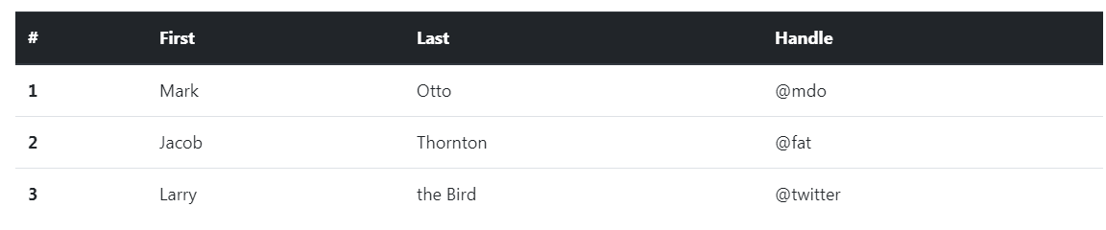
Tables
Allows the user to display important data in tabular format.
Notes:
It consist of heading,row and column,
Tables
The scope attribute defines a way to associate header cells and data cells in a table.
The scope attribute identifies whether a cell is a header for a column, row, or group of columns or rows.
td scope="col|row|colgroup|rowgroup“

Slide 44
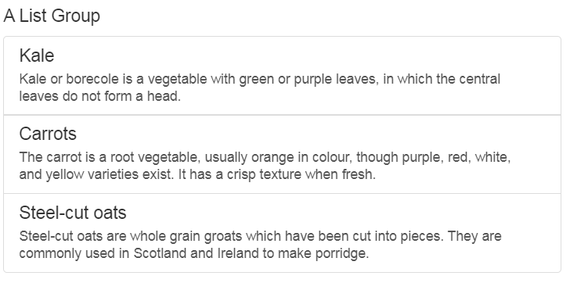
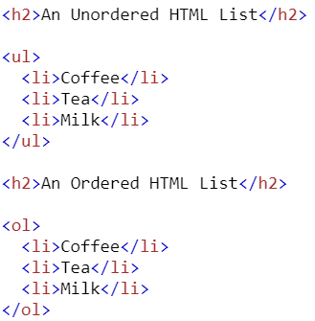
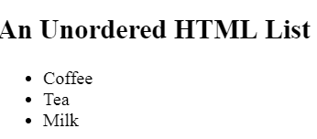
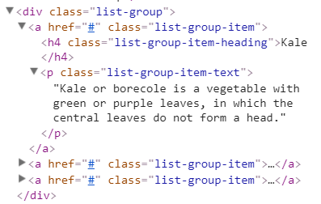
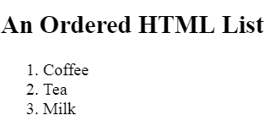
Lists
Allows user to display content in a bulleted or numbered list format.
Notes:
Lists ul/ol/li

Slide 45
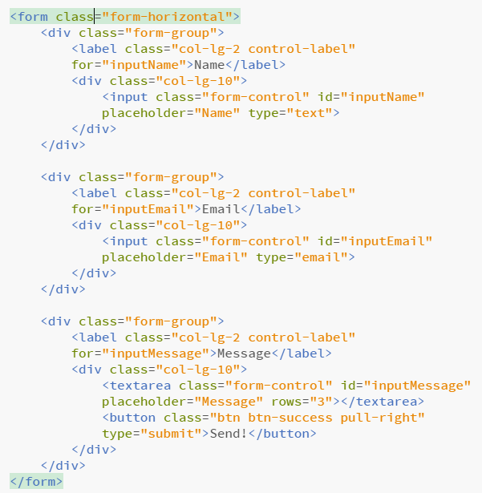
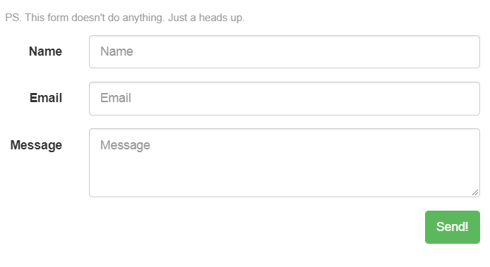
Forms
The <form> tag is used to create an HTML form for user input
Notes:
The <form> element can contain one or more of the following form elements:
<input>
<textarea>
<button>
<select>
<option>
<optgroup>
<fieldset>
<label>
Forms – grouping/borders/texts

Slide 46
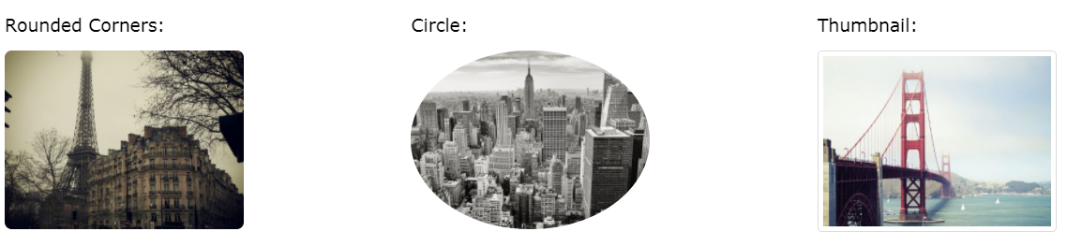
Image Thumbnails
Allows images and text to be organized in a article type of view.
Notes:
Image thumnails – class v/s borders,radius,colors
you can use .img-thumbnail to give an image a rounded 1px border appearance.
The .rounded class adds rounded corners to an image:
The .rounded-circle class shapes the image to a circle:
The .img-thumbnail class shapes the image to a thumbnail (bordered):
Create responsive images by adding an .img-fluid class to the <img> tag.
Float an image to the right with the .float-right class or to the left with .float-left:

Slide 47
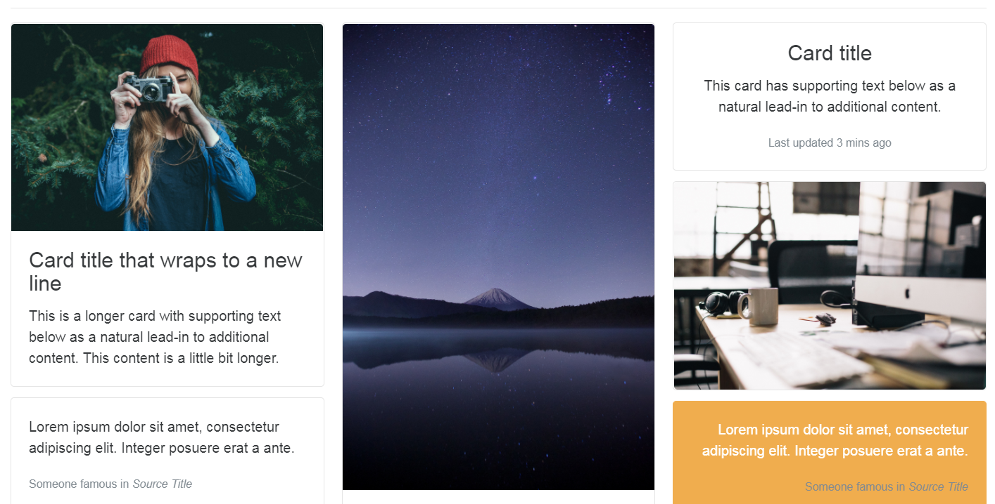
Card
A card is a flexible and extensible content container.
Notes:
Card’ –
replaces wells/panels/tabs –
is a bordered box with padding around its content.
Includes headers,footers,colors,content
It includes options for headers and footers, a wide variety of content, contextual background colors, and powerful display options
If you’re familiar with Bootstrap 3, cards replace our old panels, wells, and thumbnails
Cards are built with as little markup and styles as possible, but still manage to deliver a ton of control and customization.
Built with flexbox, they offer easy alignment and mix well with other Bootstrap components.

Slide 48
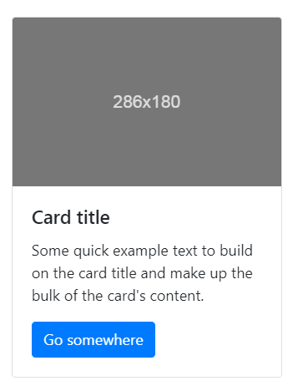
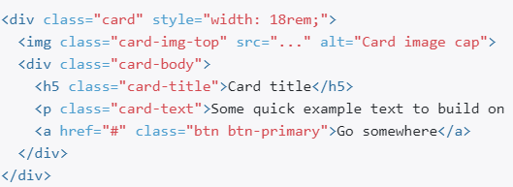
Card

Slide 49
Challenge 5
Notes:
Add a table above pagination with dark header
Make 2 images round using image thumbnails
Add list groups
Create 2 cards

Slide 50
MODULE 7: Component Set 1
Alerts
Badge & Label
Carousel
Collapse
Buttons

Slide 51
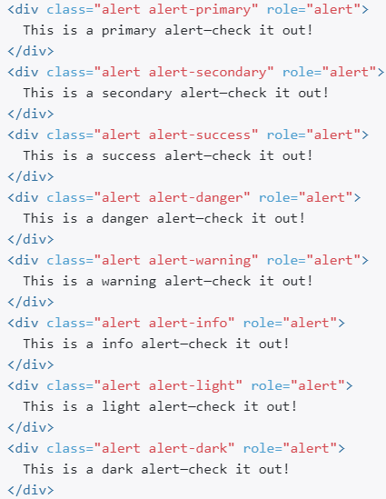
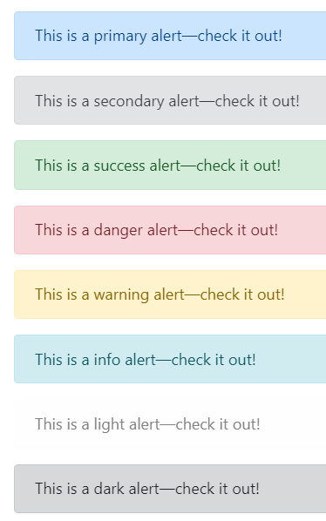
Alerts
Provide contextual feedback messages for typical user actions.

Slide 52

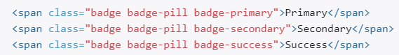
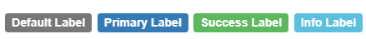


Badge & Label
Count and labeling component.
Notes:
Use the .badge-pill modifier class to make badges more rounded (with a larger border-radius and additional horizontal padding).
Depending on the specific situation, these badges may seem like random additional words or numbers at the end of a sentence, link, or button
Use the .label class, followed by one of the six contextual classes .label-default, .label-primary, .label-success, .label-info, .label-warningor .label-danger, within a <span> element to create a labe

Slide 53


Carousel
A slideshow component for cycling through elements.
Notes:
built with CSS 3D transforms and a bit of JavaScript.
It works with a series of images, text, or custom markup. It also includes support for previous/next controls and indicators

Slide 54


Collapse
Allows user to toggle the visibility of content across your project.

Slide 55




Buttons
Provides custom button styles for actions in forms, dialogs, and more.
Support for multiple sizes, states
Notes:
Conveying meaning to assistive technologies
Using color to add meaning only provides a visual indication, which will not be conveyed to users of assistive technologies – such as screen readers

Slide 56
Challenge 6
Notes:
Add alert message for start coding
Add badges at the side of card titles
Add carasol hidden ,which will collapse based on clicking green button from section 1

Slide 57
MODULE 8: Component Set 2
Jumbotron
Modal
Pop Over
Progress
Tooltips

Slide 58


Jumbotron
Lightweight, flexible component for showcasing hero unit style content.

Slide 59


Modal
To add dialogs to your site for lightboxes, user notifications, or completely custom content.

Slide 60



Popover
Popover plugin is similar to tooltips.
Notes:
it is a pop-up box that appears when the user clicks on an element. The difference is that the popover can contain much more content
Popovers rely on the 3rd party library Popper.js for positioning
Popovers require the tooltip plugin as a dependency

Slide 61





Progress
Custom progress bars featuring support for stacked bars, animated backgrounds, and text labels.
Notes:
Label
Striped

Slide 62



Tooltips
Tooltip plugin is small pop-up box that appears when the user moves the mouse pointer over an element.
Notes:
To create a tooltip, add the data-toggle="tooltip" attribute to an element.
Use the title attribute to specify the text that should be displayed inside the tooltip
Tooltips must be initialized with jQuery: select the specified element and call the tooltip() method

Slide 63
Challenge 7
Notes:
Create a modal
Add jumbotron in modal
Make a link tooltip in modal
Make learn more button click show a popover

Slide 64
MODULE 9: Utilities
Border
Colors –Text & Background
Display
Embed(I frames)
Position

Slide 65




Border
Use border utilities to quickly style the border and border-radius of an element.
Use border utilities to add or remove an element’s borders. Choose from all borders or one at a time.
Notes:
Great for images, buttons, or any other element.

Slide 66




Colors

Slide 67





Display
Quickly and responsively toggle the display value of components and more with display utilities.
Notes:
Includes support for some of the more common values, as well as some extras for controlling display when printing

Slide 68


Embed(I frames)
Create responsive video or slideshow embeds based on the width any device.
Notes:
based on intrinsic aspect ratio

Slide 69


Position
The position property specifies the type of positioning method used for an element (static, relative, absolute, fixed etc..)
Notes:
Use these shorthand utilities for quickly configuring the position of an element.
Quick positioning classes are available, though they are not responsive.
Position an element at the top of the viewport, from edge to edge, but only after you scroll past it. The .sticky-top utility uses CSS’s position: sticky, which isn’t fully supported in all browsers.

Slide 70
Challenge 8
Notes:
Change the border color for modal content to red
Add a iframe with video link of you tube

Slide 71
MODULE 10: Animations and icons
Css frames
Glyphicons
Font awesome

Slide 72


CSS frames
Add animated behavior to html elements
Notes:
https://mdbootstrap.com/css/animations/

Slide 73
Glyphicons
Bootstrap provides 260 glyphicons from the Glyphicons Halflings set.
Bootstrap 4:
Stopped support for glyphicons
<span class="glyphicon glyphicon-print"></span> Print
Notes:
Glyphicons can be used in text, buttons, toolbars, navigation, forms, etc.
While icon fonts in general do have some issues, I don't recall that being the primary consideration for dropping them. The more pressing concern was that (A) some folks don't need/want icons (B) many folks were using other icon fonts (such as Font Awesome); for folks in these circumstances, Bootstrap including its own icon font led to unnecessary bloat. Plus, dedicated icon font projects could do a better job than us.
Tertiary concerns:
How to best deal with the paths of assets (such as web fonts) in Less/Sass packages seems to be a bit of an open question. Dropping the icon font means we don't have to wrestle with this.
Since we merely packaged Glyphicons and aren't font authors ourselves, all we could do regarding reports of bugs in Glyphicons itself was forward them to the author of Glyphicons. (To his great credit, he was fairly responsive, especially considering that it was a free product.)
There are some misc. issues related to the design of Glyphicons itself and/or interactions with Bootstrap's choice of default font sizes: #13657, #15011

Slide 74


Font awesome
Compatible with a large number of screen readers.
Font Awesome provides us with the scalable vector icons and can be customised
Step 1: – Go to the Font Awesome website through this link – http://fontawesome.io/ Step 2: – Click on the http://fontawesome.io/icons/ to view the list of available 675 icons. Step 3: – Click on the download button as shown below. It will download a package named as ‘font-awesome-4.7.0’.
Step 4: – Copy the entire font-awesome directory into your project. Step 5: – In the head of your html, reference the location to your font-awesome.min.css with the following HTML code.
<link rel="stylesheet" href="path/to/font-awesome/css/font-awesome.min.css">
Step 6: – Choose the icon which you want to use from page http://fontawesome.io/icons/ . After clicking on that particular icon you can obtain the HTML code that could be embedded for that particular icon as shown below.
Notes:
Font Awesome It is widely used by Bootstrap web designers as they look great on retina display devices
that can instantly be customized in terms of size, color, drop shadow, and anything that can be done with the power of CSS.
Font Awesome version 4.7.0 is known to have around 675 icons iconic font to choose from.

Slide 75
Challenge 9
Notes:
Add css animation to section 1 text to keep changing color in infinite loop
Add user icon next to my account using font awesome library

Slide 76
Module 11: Final Challenge
Grid system
Links & Headers
Symbols

Slide 77

Grid System
Work on footer
Add grid system to the footer link below image

Slide 78
Links & Headers
Add headers
Add links using <a> (anchor ) tag

Slide 79


Symbols
Add copyright symbol
Add heart symbol

Slide 80
References
https://www.w3schools.com
getbootstrap.com
https://fontawesome.com/
https://fontawesome.bootstrapcheatsheets.com/

Slide 81


